Slide 1







Enterprise Blockchain Developers (Intermediate)
In support of
Powered By

Slide 2
Outline
Explorer Architecture
Explorer Appearance
Explorer Demo
© 2017-2020 SmartMesh Foundation Pte. Ltd. | MeshBox Foundation Pte. Ltd.

Slide 3
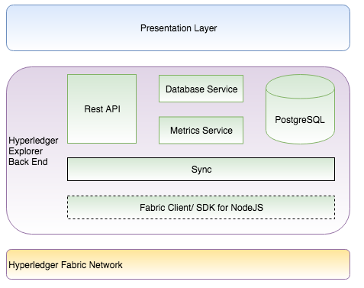
HyperLedger Explorer
Hyperledger Explorer is a simple, powerful, easy-to-use, well maintained, open source utility to browse activity on the underlying blockchain network.
It is a Search Engine for a blockchain ledger database

Slide 4
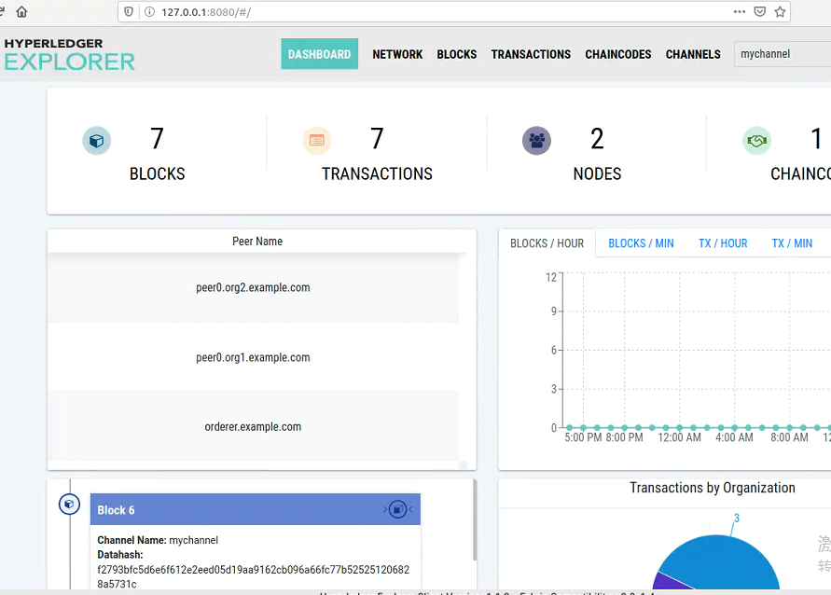
HyperLedger Explorer
Hyperledger Explorer is a simple, powerful, easy-to-use, well maintained, open source utility to browse activity on the underlying blockchain network.
It is a Search Engine for a blockchain ledger database

Slide 5
HyperLedger Explorer
Code Demo: Using Docker to intergrate Hyperledger Explorer with test network

